Slide 1
Web Technologies
CLIENT SIDE ESSENTIALS
Java Script Objects and Functions – JQuery – Accessing DOM Elements using Java Script
and JQuery Objects – Java Script Event Handling – XML DOM – AJAX Enabled Rich
Internet Applications with XML and JSON – Dynamic Access and Manipulation of Web
Pages using Java Script and JQuery – Web Speech API – Speech Synthesis Markup
Language.

Slide 2
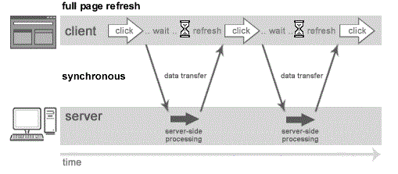
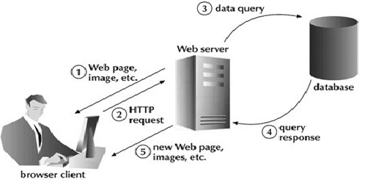
AJAX
AJAX - Asynchronous JavaScript and XML. It is a group of inter-related technologies like JavaScript, DOM, XML, HTML/XHTML, CSS, XMLHttpRequest etc.
AJAX allows you to send and receive data asynchronously without reloading the web page. So it is fast.
AJAX allows you to send only important information to the server not the entire page.
So only valuable data from the client side is routed to the server side. It makes your application interactive and faster.
Usage: There are too many web applications running on the web that are using ajax technology like gmail, facebook,twitter, google map, youtube etc.
Synchronous vs Asynchronous
Synchronous (Classic Web-Application Model)
A synchronous request blocks the client until operation completes i.e. browser is unresponsive. In such case, JavaScript engine of the browser is blocked.

Slide 3
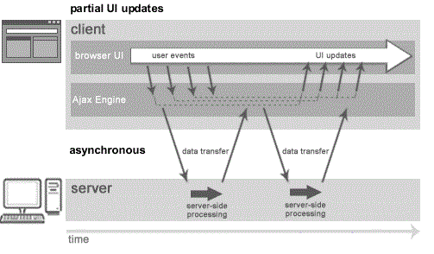
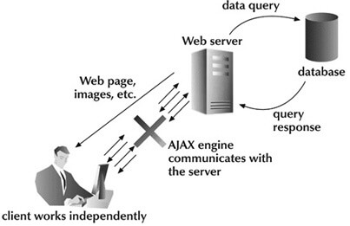
AJAX
Asynchronous (AJAX Web-Application Model)
An asynchronous request doesn’t block the client i.e. browser is responsive.
At that time, user can perform another operations also. In such case, javascript engine of the browser is not blocked.
full page is not refreshed at request time and user gets response from the ajax engine.

Slide 4
AJAX
Ajax is not a technology but group of inter-related technologies which includes:
HTML/XHTML and CSS-used for displaying content and style. It is mainly used for presentation.
DOM-used for dynamic display and interaction with data.
XML or JSON-For carrying data to and from server. JSON (Javascript Object Notation) is like XML but short and faster than XML.
XMLHttpRequest- For asynchronous communication between client and server.
JavaScript-used to bring above technologies together. Independently, it is used mainly for client-side validation.
XMLHttpRequest
An object of XMLHttpRequest is used for asynchronous communication between client and server.
It performs following operations:
Sends data from the client in the background
Receives the data from the server
Updates the webpage without reloading it.

Slide 5
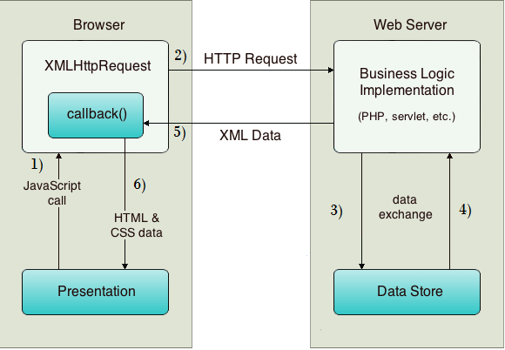
AJAX
XMLHttpRequest
User sends a request from the UI and a javascript call goes to XMLHttpRequest object.
HTTP Request is sent to the server by XMLHttpRequest object.
Server interacts with the database using JSP, PHP, Servlet, ASP.net etc.
Data is retrieved.
Server sends XML data or JSON data to the XMLHttpRequest callback function.
HTML and CSS data is displayed on the browser.

Slide 6
AJAX
XMLHttpRequest
Common properties of XMLHttpRequest object :
onReadyStateChange→It is called whenever readystate attribute changes.
It must not be used with synchronous requests.
readyState→represents the state of the request. It ranges from 0 to 4.
0 -UNOPENED open() is not called, 1 - OPENED open is called but send() is not called., 2 HEADERS_RECEIVED- send() is called, and headers and status are available,3-LOADING Downloading data; responseText holds the data;4-DONE The operation is completed fully.
reponseText→returns response as text.
responseXML→returns response as XML
Methods of XMLHttpRequest object :
void open(method, URL)→opens the request specifying get or post method and url.
void open(method, URL, async)→ opens the request specifying get or post method and url but also specifies asynchronous or not.
void open(method, URL, async, username, password)→same as previous open() method but specifies username and password.
void send()→sends get request.
void send(string)→send post request.
setRequestHeader(header,value)→it adds request headers.

Slide 7
JSON
JSON →JavaScript Object Notation.
JSON is lightweight data-interchange format, is easy to read and write than XML, is language independent, supports array, object, string, number and values.
The JSON file must be save with .json extension
JSON is an open standard for exchanging data on the web.
It supports data structures like objects and arrays. So, it is easy to write and read data from JSON.
In JSON, data is represented in key-value pairs, and curly braces hold objects, where a colon is followed after each name.
The comma is used to separate key-value pairs. Square brackets are used to hold arrays, where each value is comma-separated.
JSON has been derived from javascript
It was originally created to hold the structured data that could be used in javascript.
JSON became so popular that it is used for data for all kinds of applications. It is the most popular way of sending the data for Web APIs.

Slide 8
JSON
Nesting: Nesting involves keeping the arrays and objects inside of each other.
We can put the arrays inside objects, objects inside arrays, arrays inside arrays, etc.
We can say that json file is a big object with lots of objects and arrays inside.
Example:
{
"song" :
{
"title" : "Hey Dude";
"artist": "The Beatles";
"musicians": ["John Lennon", "Paul McCratney", "Ringo Starr"];
}
}
the song starts with a curly bracket. Therefore, a song is an object.
It contains three key-value pairs wherein title, artist and musicians are the keys.

Slide 9
XML
XML stands for an extensible markup language.
It is like HTML, where HTML stands for Hypertext Markup language.
HTML is used for creating websites, whereas XML can be used for any kind of structured data.
XML has two ways of handling data, i.e., Tags and Attributes. The tags work as HTML.
The start tags start with the <_> and end with the </_>. The start and end tags must match. The names must only be letters, numbers, and underscore, and the tag name must start with a letter only.
For example: <title> Hello World </title>
Similarities between the json and XML.
Self-describing: Both json and xml are self-describing as both xml data and json data are human-readable text.
Hierarchical: Both json and xml support hierarchical structure. Here hierarchical means that the values within values.
Data interchange format: JSON and XML can be used as data interchange formats by many different programming languages.
Parse: Both the formats can be easily parsed.
Retrieve: Both formats can be retrieved by using HTTP requests. The methods used for retrieving the data are GET, PUT, POST.

Slide 10
JSON
JSON can be created by object and array.
Each object can have different data such as text, number, boolean etc.
A JSON object contains data in the form of key/value pair.
The keys are strings and the values are the JSON types.
Keys and values are separated by colon. Each entry (key/value pair) is separated by comma.
The { (curly brace) represents the JSON object.
{
"employee": {
"name": "so",
"salary": 56000,
“currentlyworking": true
}
}
JSON Array
The [ ](square bracket) represents the JSON array.
A JSON array can have values and objects.
example of JSON array having values: ["Sunday", "Monday", "Tuesday", "Wednesday", "Thursday", "Friday", "Saturday"]

Slide 11
JSON and XML
{"employees":[
{"name":“a", "email":“abc@gmail.com"},
{"name":“b", "email":“efg@gmail.com"},
{"name":“c", "email":“pqr@gmail.com"}
]}
<employees>
<employee>
<name>a</name>
<email> abc@gmail.com </email>
</employee>
<employee>
<name>b</name>
<email> efg@gmail.com </email>
</employee>
<employee>
<name> c</name>
<email> pqr@gmail.com </email>
</employee>
</employees>

Slide 12
JSON
Data types supported by json are:
Strings: Characters that are enclosed in single or double quotation marks.
Number: A number could be integer or decimal, positive or negative.
Booleans: The Boolean value could be either true or false without any quotation marks.
Null: Here, null means nothing without any quotation marks.
Arrays
Arrays are the lists that are represented by the square brackets, and the values have commas in between them. They can contain mix data types, i.e., a single array can have strings, Boolean, numbers.
For eg.,:Example 1: [1, 2, 7.8, 5, 9, 10]; Example 2: ["red", "yellow", "green"]; Example 3: [8, "hello", null, true];
Objects
Objects are JSON dictionaries that are enclosed in curly brackets.
In objects, keys and values are separated by a colon ':', pairs are separated by comma.
Keys and values can be of any type, but the most common type for the keys is a string.
For example: {"red" : 1, "yellow" : 2, "green" : 3};

Slide 13
AJAX
JSON.stringify()→ method converts a JavaScript object or value to a JSON string, optionally replacing values if a replacer function is specified or optionally including only the specified properties if a replacer array is specified.
value
The value to convert to a JSON string.
Replacer- Optional
A function that alters the behavior of the stringification process, or an array of String and Number that serve as an allow list for selecting/filtering the properties of the value object to be included in the JSON string.
If this value is null or not provided, all properties of the object are included in the resulting JSON string.
Space- Optional
A String or Number object that's used to insert white space (including indentation, line break characters, etc.) into the output JSON string for readability purposes.
JSON.parse()→ method parses a JSON string, constructing the JavaScript value or object described by the string
JSON.parse(text)
JSON.parse(text, reviver)
Text→The string to parse as JSON
reviver -Optional
this prescribes how the value originally produced by parsing is transformed, before being returned.
Return value
The Object, Array, string, number, boolean, or null value corresponding to the given JSON text.

Slide 14
AJAX
JSON is to exchange data to/from a web server.
When sending data to a web server, the data has to be a string.
Convert a JavaScript object into a string with JSON.stringify().
The localStorage read-only property of the window interface allows you to access a Storage object for the Document's origin; the stored data is saved across browser sessions.
localStorage data has no expiration time, sessionStorage data gets cleared when the page session ends — that is, when the page is closed.
Const- Constants are block-scoped, much like variables declared using the let keyword. The value of a constant can't be changed through reassignment (i.e. by using the assignment operator), and it can't be redeclared (i.e. through a variable declaration). However, if a constant is an object or array its properties or items can be updated or removed.
let allows you to declare variables that are limited to the scope of a block statement, or expression on which it is used, unlike the var keyword, which declares a variable globally, or locally to an entire function regardless of block scope.
<!DOCTYPE html>
<html>
<body>
<h2>Store and retrieve data from local storage.</h2>
<p id="demo"></p>
<script>
// Storing data:
const myObj = { name: "abc", age: 10, city: "Chennai" };
const myJSON = JSON.stringify(myObj);
localStorage.setItem("testJSON", myJSON);
// Retrieving data:
let text = localStorage.getItem("testJSON");
let obj = JSON.parse(text);
document.getElementById("demo").innerHTML = obj.name;
</script>
</body>
</html>

Slide 15
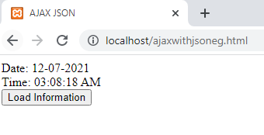
AJAX
request.onreadystatechange = function(){
if (request.readyState == 4 )
{
var jsonObj = JSON.parse(request.responseText);
//JSON.parse() returns JSON object
document.getElementById("date").innerHTML = jsonObj.date;
document.getElementById("time").innerHTML = jsonObj.time;
} }
request.open("GET", url, true);
request.send(); }
</script>
</head>
<body>
Date: <span id="date"></span><br/>
Time: <span id="time"></span><br/>
<button type="button" onclick="load()">Load Information</button>
</body>
</html>
//date.json
{
"date": "12-07-2021",
"milliseconds_since_epoch": 1638975564424,
"time": "03:08:18 AM"
}
<html>
<head>
<meta content="text/html; charset=utf-8">
<title>AJAX JSON</title>
<script type="application/javascript">
function load()
{
var url = "date.json";
var request;
if(window.XMLHttpRequest){
request=new XMLHttpRequest();
//for Chrome, mozilla etc
}
else if(window.ActiveXObject){
request=new ActiveXObject("Microsoft.XMLHTTP");
//for IE only
}

